Slide 1
Computational Thermal Engineering
Mathematical description of physical phenomena
(Numerical methods) – DAY 3
Kumaresh Selvakumar

Slide 2
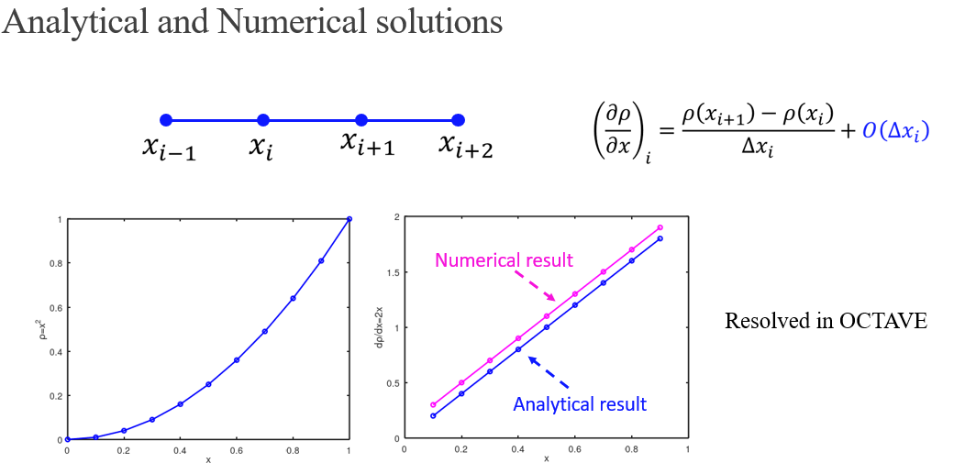
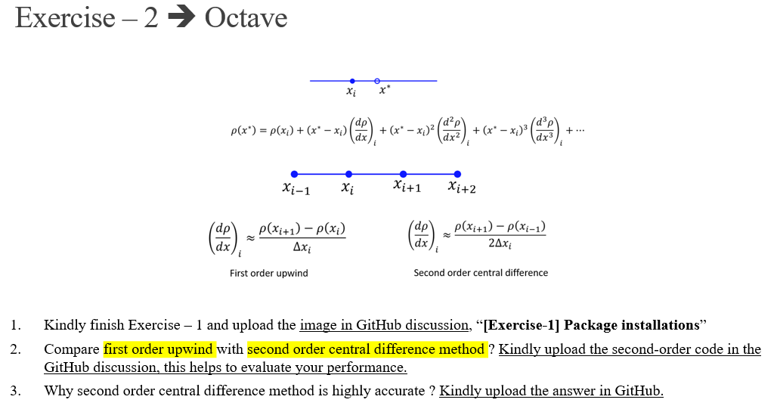
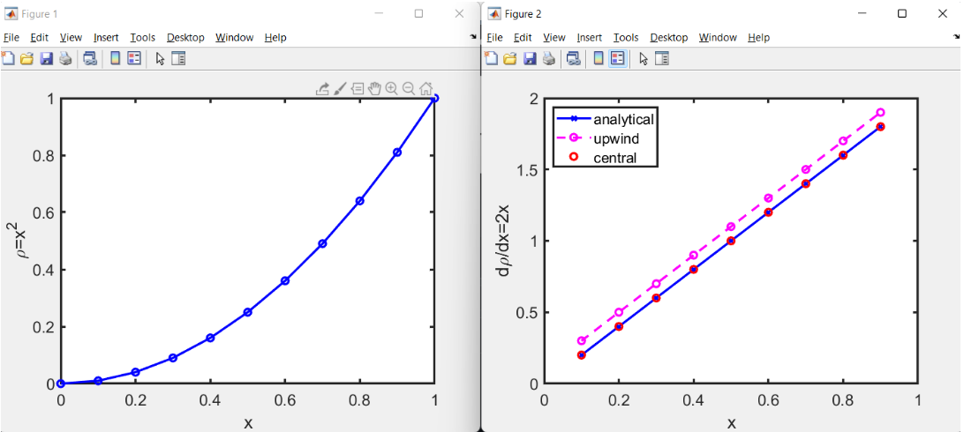
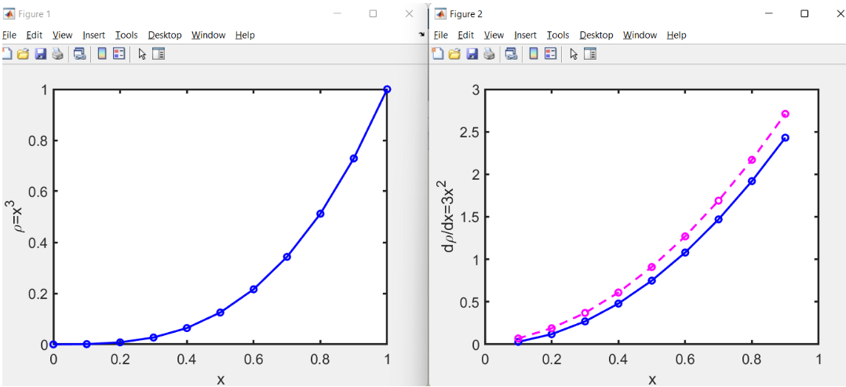
Quick Recap

Slide 3
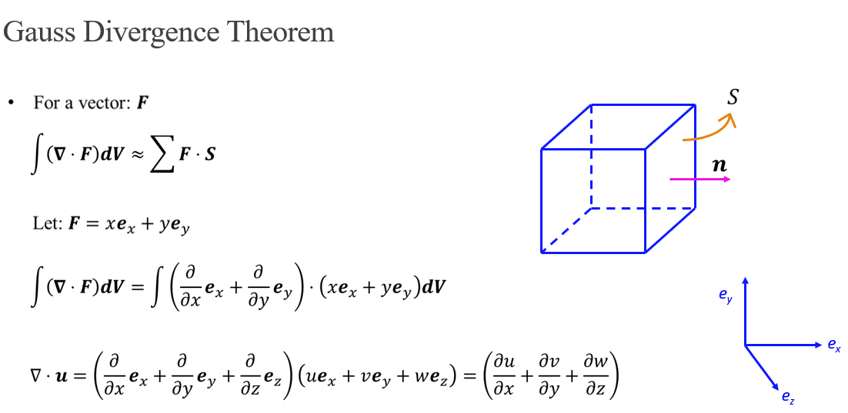
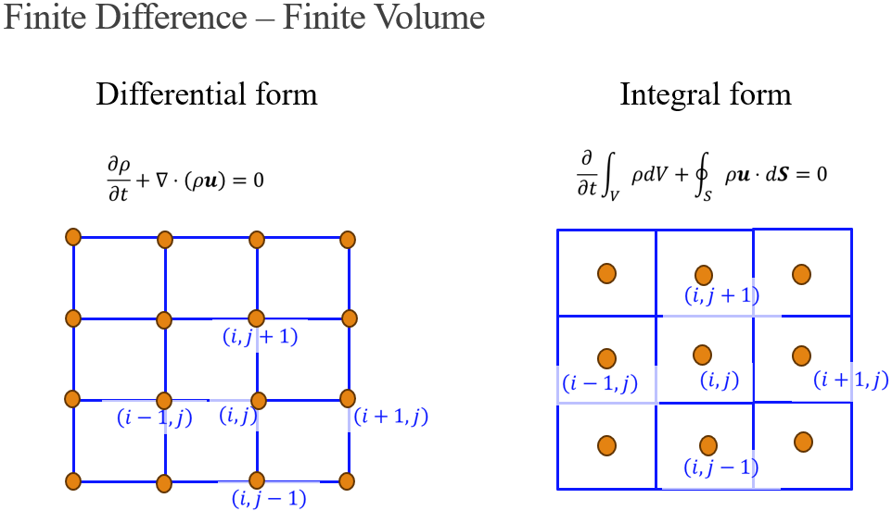
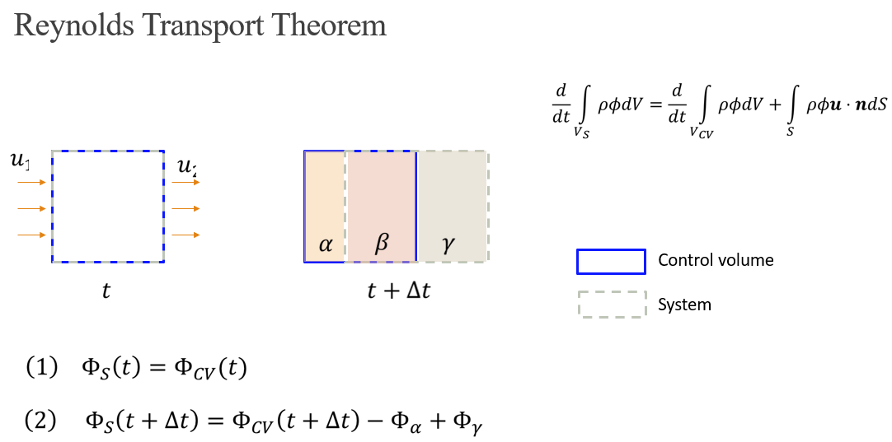
Quick Recap

Slide 4
Contents
Taylor series expansion and FDM
First order backward difference method – Exercise – 3
Numerical discretization – Grid layout
Second order derivative – Exercise – 4

Slide 5
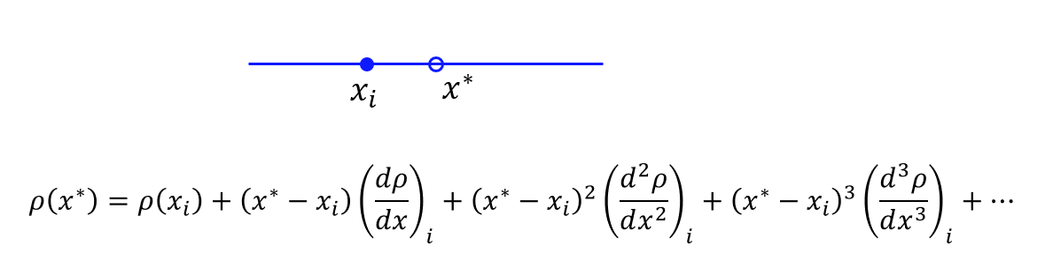
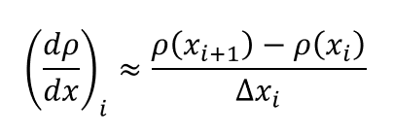
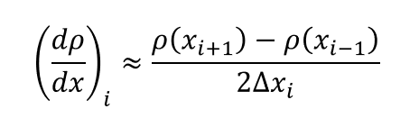




First order and second order schemes
Please take a note of everything in pen and paper. Your notes are evaluated.
$$x_{i−1}$$
$$x_{i}$$
$$x_{i+1}$$
$$x_{i+2}$$
First order forward difference
Second order central difference

Slide 6
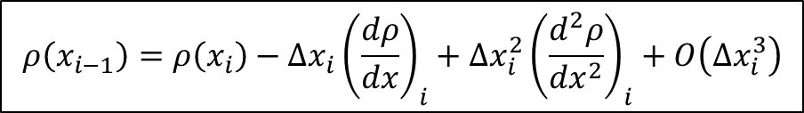
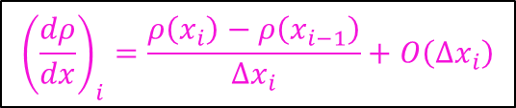
First order backward difference scheme – Exercise 3
https://github.com/Kumaresh0402/ComputationalThermalEngineering/discussions/5
$$x_{i−1}$$
$$x_{i}$$
$$x_{i+1}$$
$$x_{i+2}$$
Exercise – 3:
Use pen and paper to derive first order backward difference method.
Compare forward, backward and central first order derivatives in Octave.
Paste the respective images in the GitHub and state your comments.
$$ρ\left(x_{i−1}\right)=ρ\left(x_{i}\right)−Δx_{i}{\left(\frac{dρ}{dx}\right)}_{i}+Δx_{i}^{2}{\left(\frac{d^{2}ρ}{dx^{2}}\right)}_{i}+O\left(Δx_{i}^{3}\right)$$
$${\left(\frac{dρ}{dx}\right)}_{i}=\frac{ρ\left(x_{i}\right)−ρ\left(x_{i−1}\right)}{Δx_{i}}+O\left(Δx_{i}\right)$$

Slide 8



Numerical Discretization (Grid layout)
$$u$$
$$e_{y}$$
$$e_{x}$$
Notes:
Hand draw velocity vectors.
Then click to overlay mesh

Slide 9






Numerical Discretization (Grid layout)
Please take a note of everthing in pen and paper. Your notes are evaluated.
$$u$$
$$e_{y}$$
$$\left(i,j+1\right)$$
$$e_{x}$$
$$\left(i−1,j\right)$$
$$\left(i,j\right)$$
$$\left(i+1,j\right)$$
$$\left(i,j−1\right)$$
Flow properties are assigned at each grid locations.
Notes:
Hand draw velocity vectors.
Then click to overlay mesh

Slide 10











Numerical Discretization (Grid layout)
$$u$$
$$e_{y}$$
$$\left(i,j+1\right)$$
$$e_{x}$$
$$\left(i−1,j\right)$$
$$\left(i,j\right)$$
$$\left(i+1,j\right)$$
$$\left(i,j−1\right)$$
$$\left(i,j+1\right)$$
Cell centered representation
$$\left(i−1,j\right)$$
$$\left(i,j\right)$$
$$\left(i+1,j\right)$$
$$\left(i,j−1\right)$$
Notes:
Hand draw velocity vectors.
Then click to overlay mesh

Slide 11














Numerical Discretization (Grid layout)
Cell centered representation
$$v$$
$$e_{y}$$
$$p$$
$$u, v, p$$
$$u$$
$$\left(i,j+1\right)$$
$$\left(i,j+1\right)$$
$$e_{x}$$
$$\left(i−1,j\right)$$
$$\left(i,j\right)$$
$$\left(i+1,j\right)$$
$$\left(i−1,j\right)$$
$$\left(i,j\right)$$
$$\left(i+1,j\right)$$
$$\left(i,j−1\right)$$
$$\left(i,j−1\right)$$
Staggered grid
Collocated grid
Notes:
Multiple clicks
Collocated grid in OpenFOAM

Slide 12
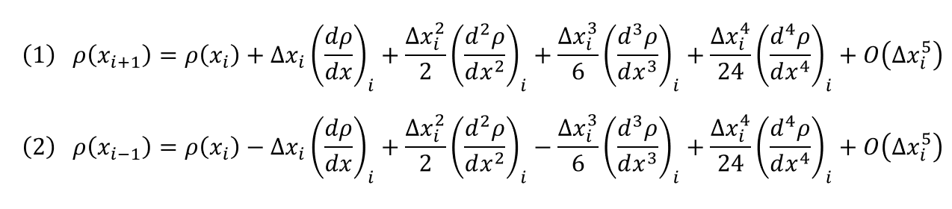
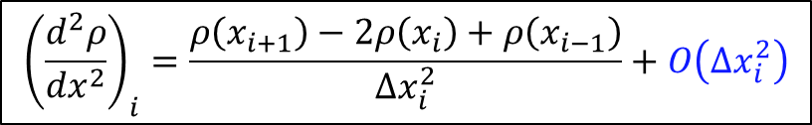
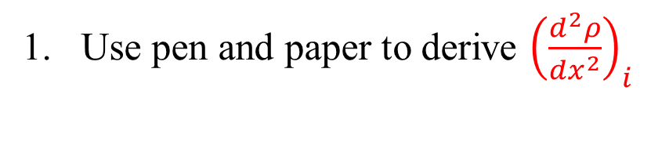
Exercise – 4
Use pen and paper to derive ${\left(\frac{d^{2}ρ}{dx^{2}}\right)}_{i}$
$$x_{i−1}$$
$$x_{i}$$
$$x_{i+1}$$
$$x_{i+2}$$
HINT:
$${\left(\frac{d^{2}ρ}{dx^{2}}\right)}_{i}=\frac{ρ\left(x_{i+1}\right)−2ρ\left(x_{i}\right)+ρ\left(x_{i−1}\right)}{Δx_{i}^{2}}+O\left(Δx_{i}^{2}\right)$$

Slide 13
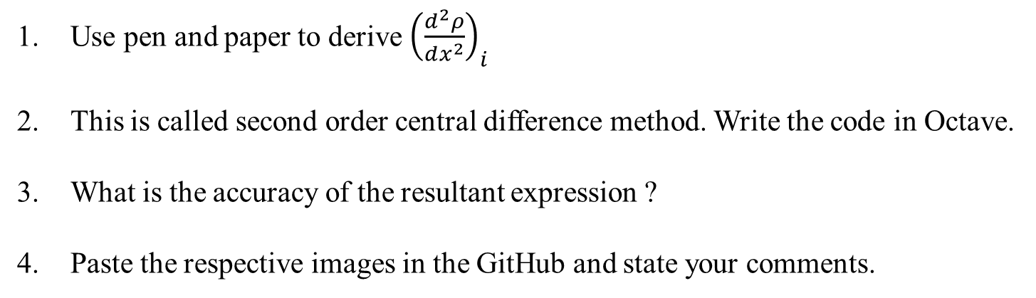
Exercise – 4
https://github.com/Kumaresh0402/ComputationalThermalEngineering/discussions/6
$$x_{i−1}$$
$$x_{i}$$
$$x_{i+1}$$
$$x_{i+2}$$
Use pen and paper to derive ${\left(\frac{d^{2}ρ}{dx^{2}}\right)}_{i}$
This is called second order central difference method. Write the code in Octave.
What is the accuracy of the resultant expression ?
Paste the respective images in the GitHub and state your comments.

Slide 15

Approximating Second Order Derivative
${\left(\frac{d^{2}ρ}{dx^{2}}\right)}_{i}$
$$x_{i−1}$$
$$x_{i}$$
$$x_{i+1}$$
$$x_{i+2}$$
$$ρ\left(x_{i+1}\right)=ρ\left(x_{i}\right)+\left(x_{i+1}−x_{i}\right){\left(\frac{dρ}{dx}\right)}_{i}+\frac{{\left(x_{i+1}−x_{i}\right)}^{2}}{2}{\left(\frac{d^{2}ρ}{dx^{2}}\right)}_{i}+\frac{{\left(x_{i+1}−x_{i}\right)}^{3}}{6}{\left(\frac{d^{3}ρ}{dx^{3}}\right)}_{i}+\frac{{\left(x_{i+1}−x_{i}\right)}^{4}}{24}{\left(\frac{d^{4}ρ}{dx^{4}}\right)}_{i}+…$$
$$\left(1\right) ρ\left(x_{i+1}\right)=ρ\left(x_{i}\right)+Δx_{i}{\left(\frac{dρ}{dx}\right)}_{i}+\frac{Δx_{i}^{2}}{2}{\left(\frac{d^{2}ρ}{dx^{2}}\right)}_{i}+\frac{Δx_{i}^{3}}{6}{\left(\frac{d^{3}ρ}{dx^{3}}\right)}_{i}+\frac{Δx_{i}^{4}}{24}{\left(\frac{d^{4}ρ}{dx^{4}}\right)}_{i}+O\left(Δx_{i}^{5}\right)$$
$$\left(2\right) ρ\left(x_{i−1}\right)=ρ\left(x_{i}\right)−Δx_{i}{\left(\frac{dρ}{dx}\right)}_{i}+\frac{Δx_{i}^{2}}{2}{\left(\frac{d^{2}ρ}{dx^{2}}\right)}_{i}−\frac{Δx_{i}^{3}}{6}{\left(\frac{d^{3}ρ}{dx^{3}}\right)}_{i}+\frac{Δx_{i}^{4}}{24}{\left(\frac{d^{4}ρ}{dx^{4}}\right)}_{i}+O\left(Δx_{i}^{5}\right)$$

Slide 16
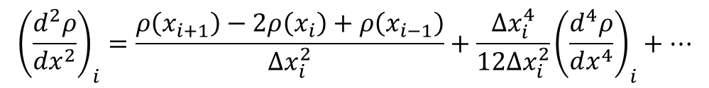
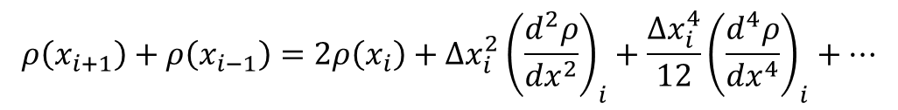
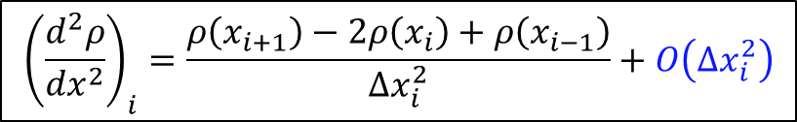
Approximating Second Order Derivative
$$x_{i−1}$$
$$x_{i}$$
$$x_{i+1}$$
$$x_{i+2}$$
Add (1) and (2)
$$ρ\left(x_{i+1}\right)+ρ\left(x_{i−1}\right)=2ρ\left(x_{i}\right)+Δx_{i}^{2}{\left(\frac{d^{2}ρ}{dx^{2}}\right)}_{i}+\frac{Δx_{i}^{4}}{12}{\left(\frac{d^{4}ρ}{dx^{4}}\right)}_{i}+…$$
$${\left(\frac{d^{2}ρ}{dx^{2}}\right)}_{i}=\frac{ρ\left(x_{i+1}\right)−2ρ\left(x_{i}\right)+ρ\left(x_{i−1}\right)}{Δx_{i}^{2}}+\frac{Δx_{i}^{4}}{12Δx_{i}^{2}}{\left(\frac{d^{4}ρ}{dx^{4}}\right)}_{i}+…$$
$${\left(\frac{d^{2}ρ}{dx^{2}}\right)}_{i}=\frac{ρ\left(x_{i+1}\right)−2ρ\left(x_{i}\right)+ρ\left(x_{i−1}\right)}{Δx_{i}^{2}}+O\left(Δx_{i}^{2}\right)$$

Slide 17
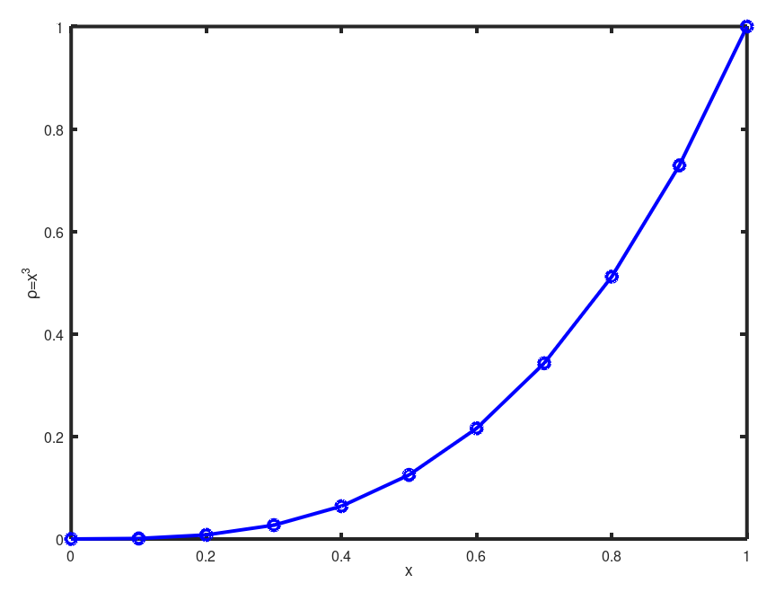
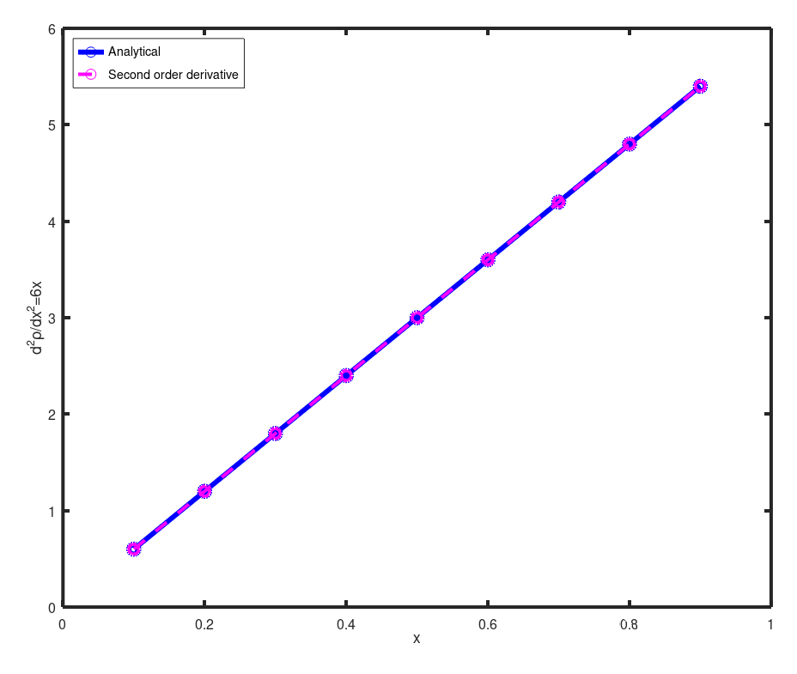
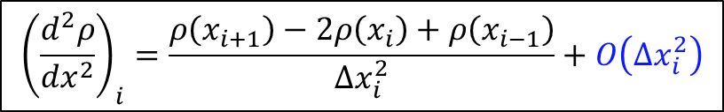
Approximating Second Order Derivative
$${\left(\frac{d^{2}ρ}{dx^{2}}\right)}_{i}=\frac{ρ\left(x_{i+1}\right)−2ρ\left(x_{i}\right)+ρ\left(x_{i−1}\right)}{Δx_{i}^{2}}+O\left(Δx_{i}^{2}\right)$$

Slide 19
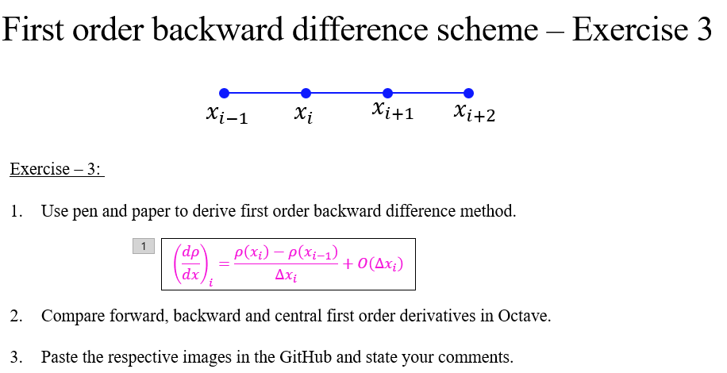
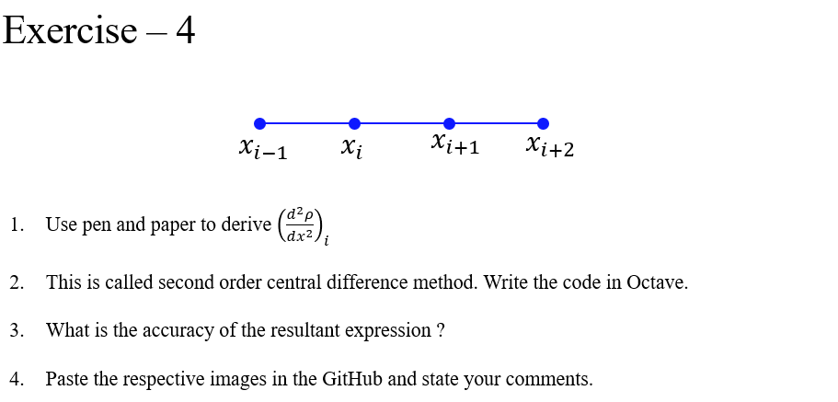
Exercises

